Slide 1
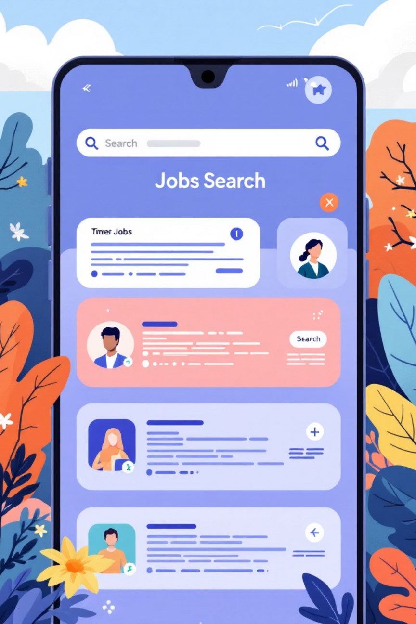

AI Job Matcher
AI-Based Job Recommendation System for Students
Project Review – I
SGP Project
Team Members:
[Your Name(s)]
Guide/Supervisor:
[Guide Name]
Date: 31/01/2026
Notes:
1

Slide 2

Project Overview & Problem Statement
What is AI Job Matcher?
Key Problems
A web-based platform for resume-based job matching and personalized recommendations.
Difficulty matching skills to job opportunities
Manual job search is time-consuming
Lack of AI-driven personalized recommendations
Target Users: Students and Admins
Domain: Career Technology + Web Development
Notes:
2

Slide 3
Objectives & System Architecture
Project Objectives
Build a resume-based job matching platform
Provide personalized recommendations to students
Implement student dashboard and admin panel
System Architecture
React-based single-page application
Component-based UI with React Router navigation
LocalStorage for data persistence
Rule-based job matching logic
Implementation Flow
User Registration → Login → Dashboard → Resume Upload → Job Listing → Recommendations → Admin Panel
Notes:
3

Slide 4
Project Progress – Review I
Completed Modules
✓ UI Design & Authentication System
✓ Student Dashboard & Resume Upload
✓ Job Listings & Filtering System
✓ Admin Panel & User Management
✓ Navigation System
Project Status
All planned modules implemented and functional. System demonstrates complete frontend implementation with protected routes, data persistence, and seamless navigation.
Key Features Implemented
Student: Registration, Dashboard, Resume Upload, Job Listings, Filters, Recommendations
Admin: Dashboard, Job Management, User Management, Analytics
Notes:
4

Slide 5
Future Scope & Next Phase
Backend & Data Layer:
Security Enhancements:
Backend development using Node.js & Express
REST API integration for secure data communication
Database integration using MongoDB / PostgreSQL
Cloud-based data storage and synchronization
Role-based access control (RBAC)
Encrypted data communication
JWT-based authentication
Secure session handling
AI & Intelligence:
Feature Enhancements:
Resume parsing using NLP techniques
Skill extraction using machine learning models
Intelligent job matching & ranking algorithms
Predictive recommendation system
Recruiter account module
Real-time job alerts & notifications
Application tracking dashboard
Interview scheduling system
Analytics & performance insights
Notes:
5

Slide 6
Project Impact & Conclusion
Academic Impact
User Impact
Full-Stack Development
Career Guidance
Modern web development practices
Personalized recommendations
AI System Design
Smart Discovery
Recommendation algorithms
Efficient job matching
Software Engineering
Skill Alignment
Real-world architecture
Accurate skill-based matching
Conclusion
AI Job Matcher demonstrates a complete AI-based job matching platform integrating modern web technologies, structured
architecture, and smart recommendation logic. Strong foundation for future AI-driven career guidance systems.
Team Contribution
Frontend Development & UI Design
Authentication System & Routing
Admin Panel & Data Management
Logic Implementation & Testing
Thank You
Project Review – I | AI Job Matcher – Smart Career Guidance Platform | Ready for Demonstration
Notes:
6

